Slide 1
EXPLORING TRAFFIC DISCIPLINARY SUMMONS: A DATA-DRIVEN ANALYSIS OF VIOLATIONS AT NORTHERN UNIVERSITY OF MALAYSIA (UUM) FROM JAN 2023 TO DEC 2023
Yap Jia Qing (278688) Vincent Beh Hua Eik (279018) Qithfirul Arsyad Alfaqih (284168) Muhammad Amir Haziq Bin Abd Karim (281678)

Slide 2
INTRODUCTION
Objective and Data Source:
The study aims to understand patterns and trends in traffic violations by analyzing disciplinary summonses. Data obtained from the Security Department at the Northern University of Malaysia (UUM). Dataset covers Statistics Of Traffic Disciplinary Summons from Jan 2023 to Dec 2023. 20 types of traffic violations and 118 records analyzed. Visualisations reveal patterns and trends in traffic disciplinary summonses.

Slide 3
INTRODUCTION (cont')
Visualisations:
Three key pieces of information extracted for insightful visualisations.Visualisations include: --Distribution of Summons by Vehicle Category (pie chart) --Total Mistakes per Month (bar chart) --Summons Total per Month (RM) (bar chart) The paper presents insights derived from the visualizations, providing a foundation for informed decision-making.

Slide 4
Problem Statement
Through the visualization of temporal trends in summons occurrence, categorized by both type and time events, we gain a comprehensive understanding of the patterns and other contributing factors. This analysis enables us to pinpoint recurring patterns and common triggers associated with specific types of summons for each vehicle category. Additionally, by comparing the occurrence of different types of summons over time, we can assess the effectiveness of any implemented measures or interventions in reducing their frequency.

Slide 5
Exploratory Data Analysis(EDA)
Method Used for EDA
head(df) str(df) summ_Ukdata=summary(df[,-c(1,2,3)])

Slide 6
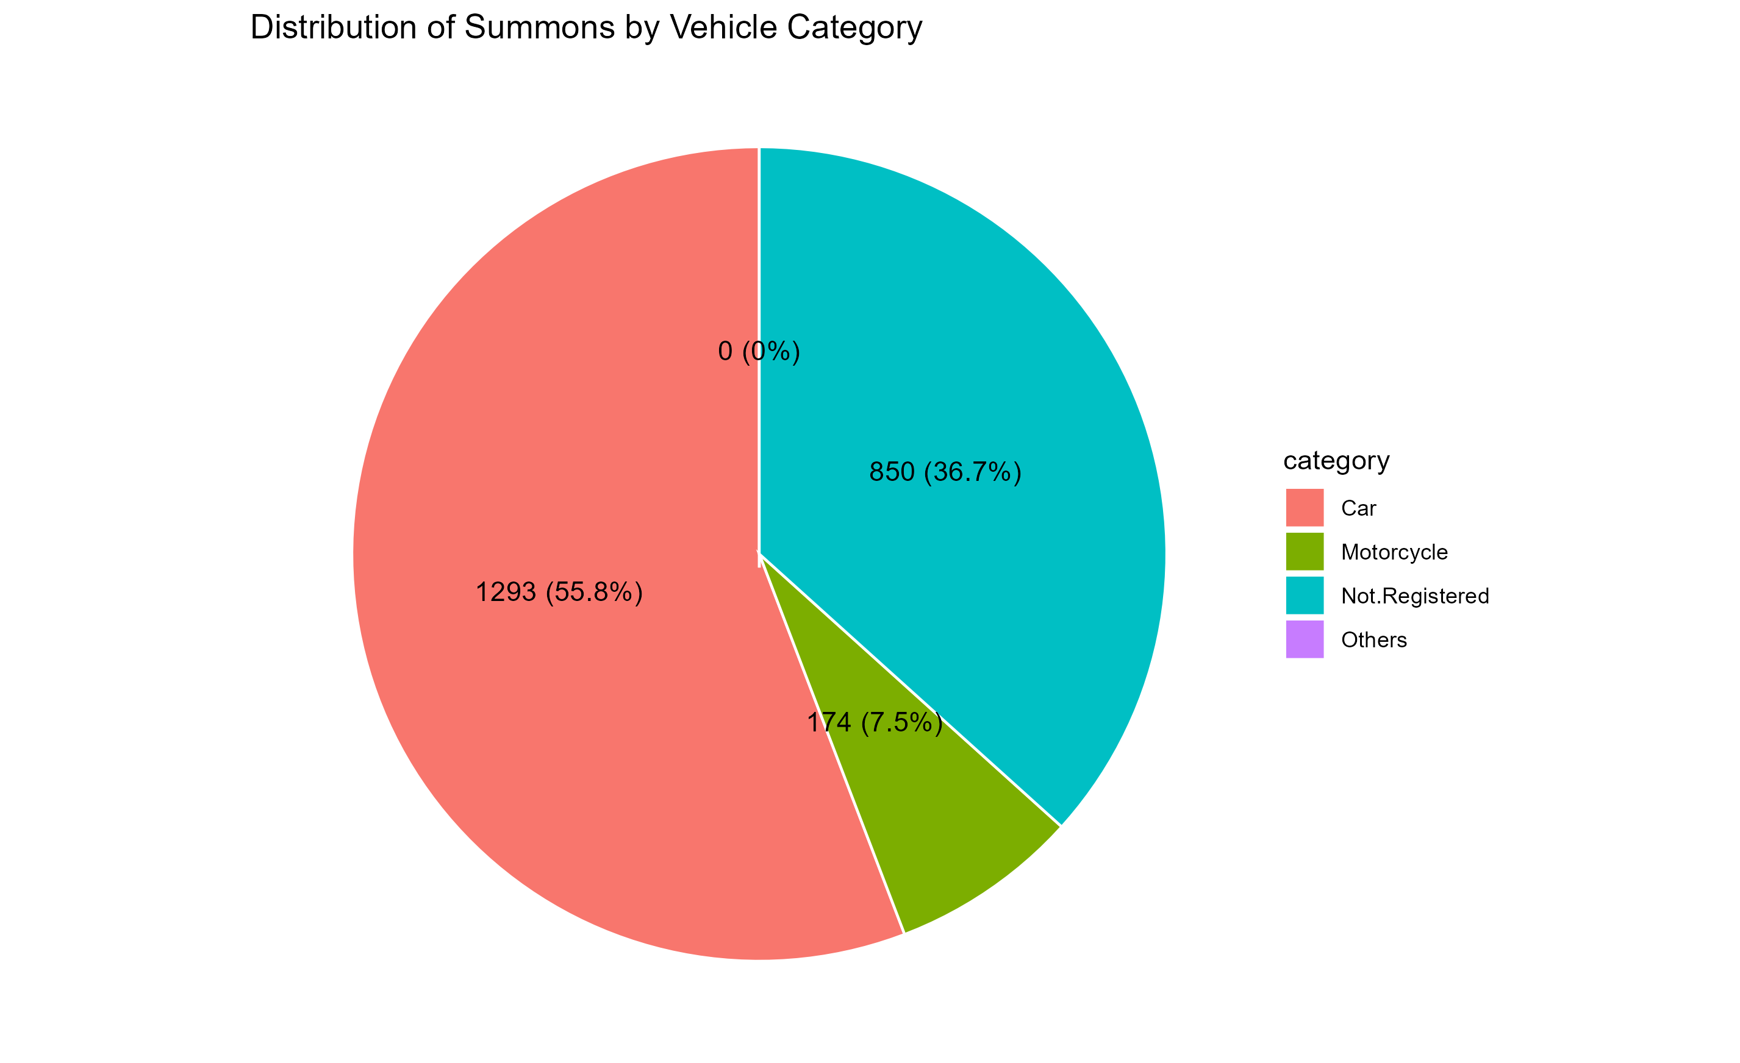
Findings 1

Slide 7
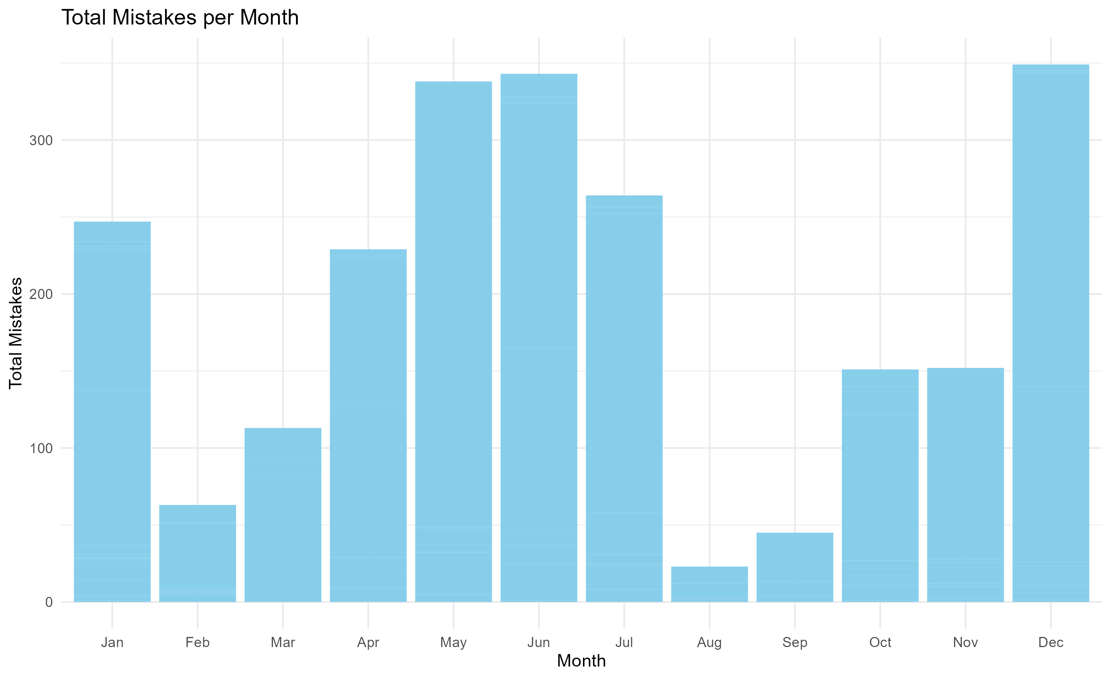
Findings 2

Slide 8
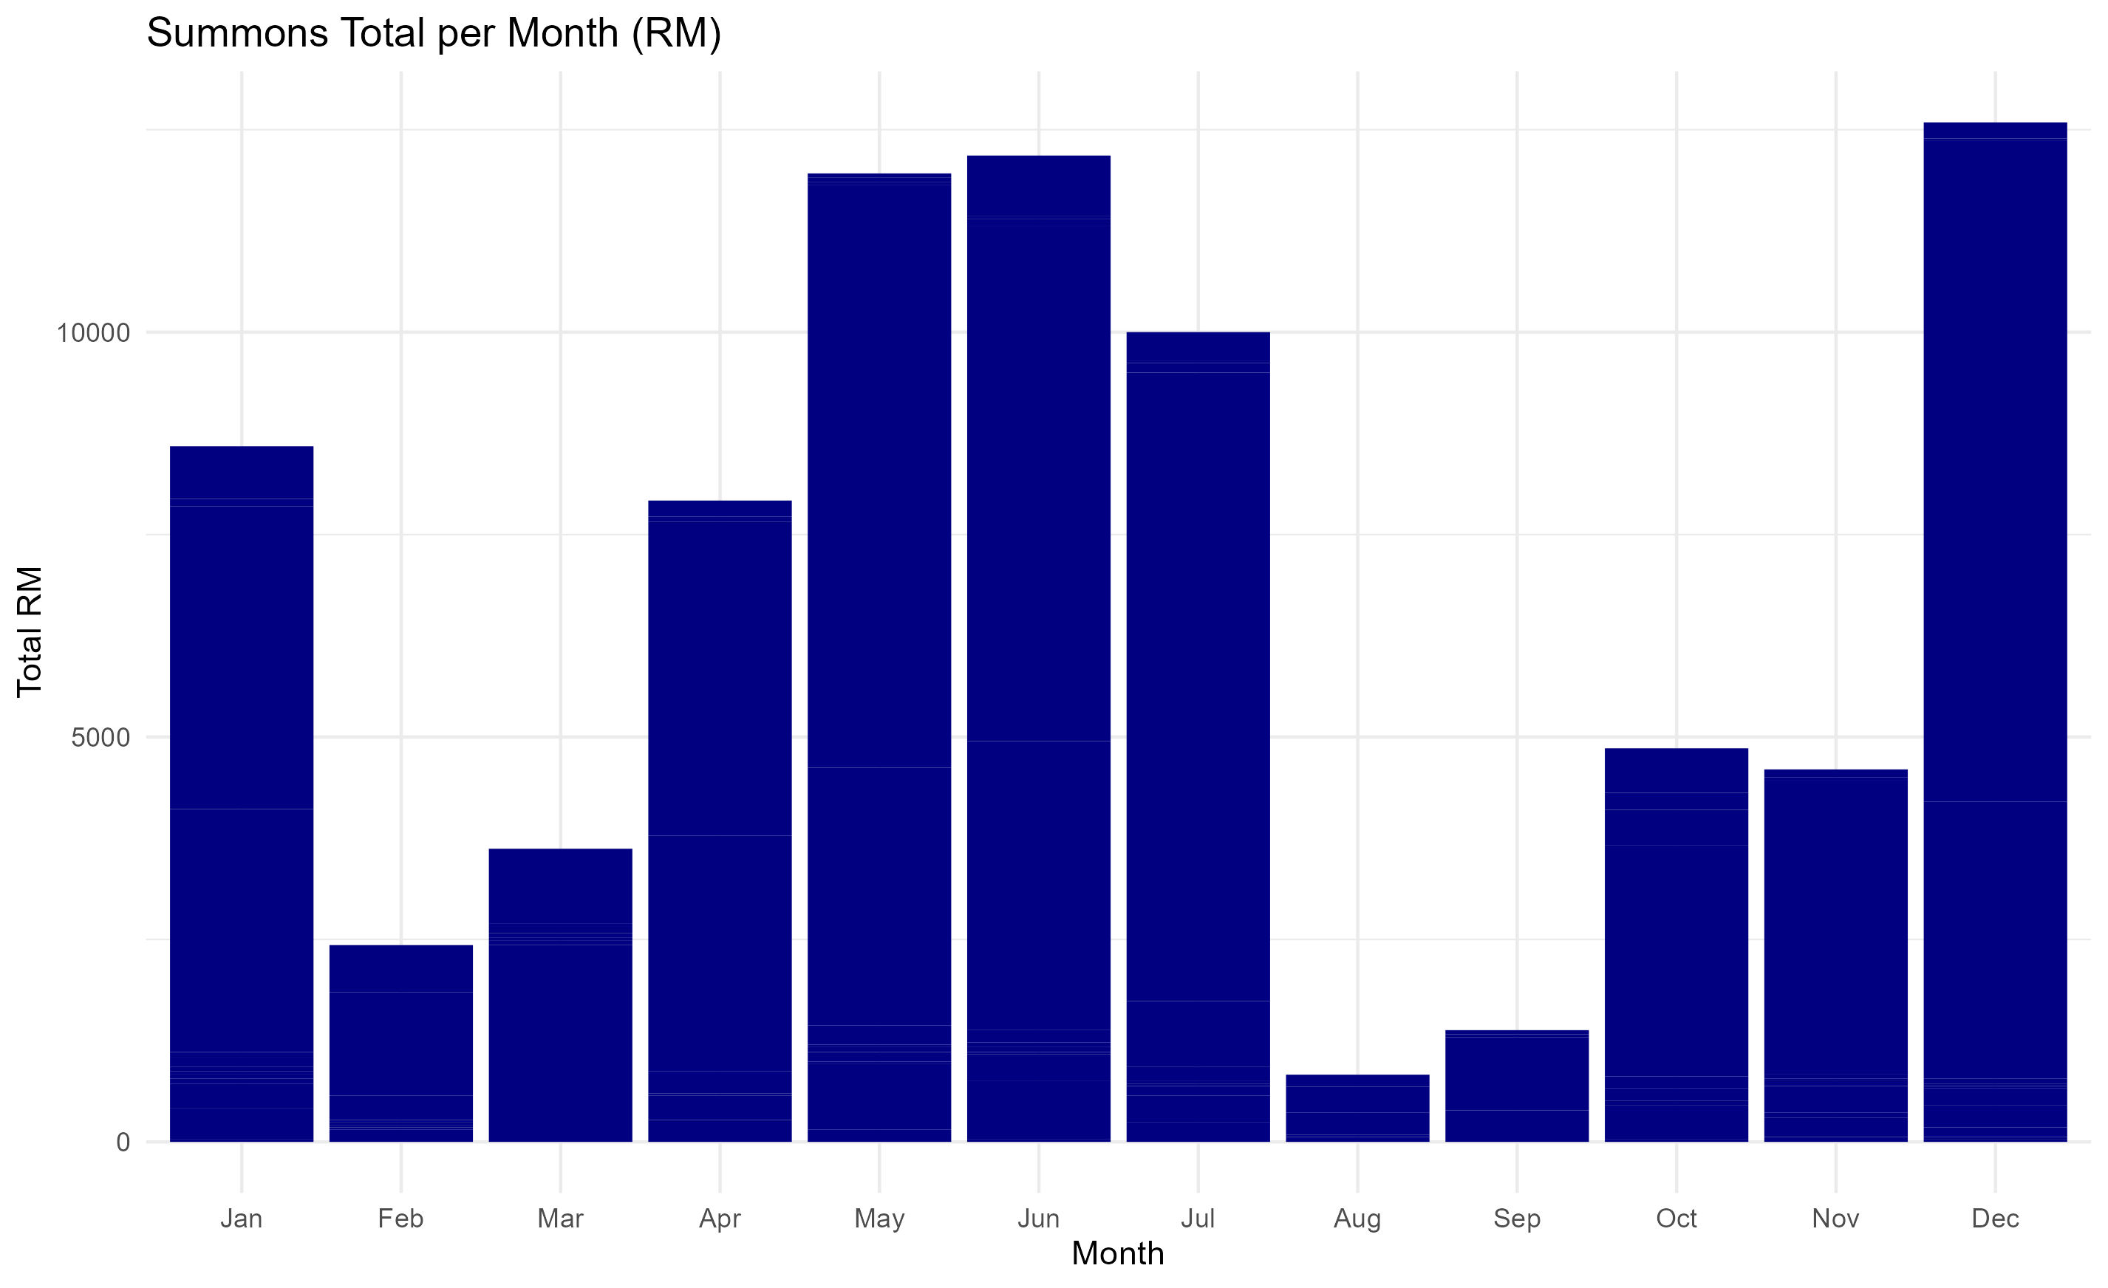
Findings 3

Slide 9
Conclusion
Comprehensive analysis of UUM Security Department's traffic disciplinary summons for 2023. Research contributes to understanding traffic violations, providing a foundation for future policy adjustments. Valuable insights for university administrators, security personnel, and researchers interested in campus safety. Emphasizes importance of data-driven decision-making for addressing traffic challenges on campuses. UUM can leverage analysis insights to develop targeted strategies for enhancing traffic discipline.

